Slide 1


Title
Detty December: Economic Impact and Public Safety Implications in Lagos
Subtitle
Assessing seasonal economic gains, visitor pressure, and infrastructure risk during peak tourism periods.
Prepared by
Data Analytics Project
Bukola Aina
Date
December, 2025

Slide 2
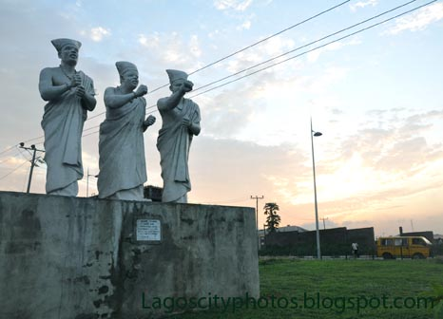
1 –
Business Understanding –High Level
This Photo by Unknown Author is licensed under CC BY-SA
Notes:
For the High Level Business Understanding focus on the Case Study supplied.

Slide 3
Case Study
Detty December in Lagos State: An Economic Impact and Sustainability Analysis of a Seasonal Tourism Engine

Slide 4

Introduction
Detty December has emerged as a major seasonal tourism and entertainment phenomenon in Lagos State, attracting large volumes of domestic and international visitors during the month of December. The influx is driven by concerts, nightlife, festivals, and social events, generating significant economic activity across hospitality, entertainment, aviation, and related sectors. As a result, Detty December has become an important contributor to short-term revenue generation and employment opportunities within the state.
However, the economic benefits associated with Detty December are highly concentrated within a narrow time window, leading to sharp increases in population movement, road usage, and public space congestion. This sudden surge places considerable pressure on transport infrastructure and emergency response systems that are largely designed for average, year-round demand rather than peak seasonal loads. Recent incidents involving road traffic accidents and delayed emergency response highlight the real-world risks associated with this imbalance.
This project examines the economic impact of Detty December alongside its implications for infrastructure strain and public safety. Using a data-driven approach, the analysis estimates peak-season revenue, identifies the sectors that benefit most from the event, and evaluates how concentrated economic activity during December compares to non-peak periods. By linking economic intensity with seasonal visitor pressure, the study aims to provide evidence-based insights that can support proactive transport planning, emergency service deployment, and policy interventions designed to reduce preventable risk while sustaining economic gains.

Slide 5
5W 1H Analysis
1 – Who
# | Question | Answer
Q1.1 | Who is involved? | Lagos State Government and regulatory agencies Hospitality operators (hotels, short-let providers) Airlines and aviation authorities Event organizers and entertainment businesses Local service providers (transport, security, vendors)
Q1.2 | Who is affected? | Lagos residents (traffic, housing pressure, cost of living) Local businesses dependent on seasonal demand Infrastructure providers (transport, power, security) Visitors (pricing, congestion, service quality)
Q1.3 | Who will benefit? | Hospitality and accommodation providers Event and entertainment operators Government through tourism-related revenue Informal and temporary workers benefiting from increased demand
Q1.4 | Who will be harmed? | Residents facing congestion, rent inflation, and service strain Small businesses unable to scale for peak demand Infrastructure systems operating beyond capacity during peak periods
Notes:
The questions on this slide are sourced from this article:
https://premium.wpmudev.org/blog/a-simple-sure-fire-way-to-create-great-content-the-5-w-the-h/
Who is involved?
Who is affected?
Who will benefit?
Who will be harmed?

Slide 6
5W 1H Analysis
2 – What
# | Question | Answer
Q2.1 | What is your topic narrowed down in a simple phrase/sentence? | An economic impact and sustainability analysis of Detty December as a seasonal revenue driver in Lagos State.
Q2.2 | What does your topic involve? (i.e. What are the different parts to it?) | Visitor inflow (aviation activity) Accommodation demand (hotels and short-stay rentals) Events and entertainment activity Revenue concentration and seasonality Infrastructure and operational constraints
Q2.3 | What is it similar to / different from? | Similar to seasonal tourism economies (e.g., holiday travel peaks) Different due to its heavy concentration in a short time window and limited infrastructure planning
Q2.4 | What might be affected/changed by your topic? | Tourism policy and planning decisions Infrastructure investment priorities Revenue optimization strategies Long-term sustainability of seasonal tourism growth
Notes:
The questions on this slide are sourced from this article:
https://premium.wpmudev.org/blog/a-simple-sure-fire-way-to-create-great-content-the-5-w-the-h/
What is your topic narrowed down in a simple phrase/sentence?
What does your topic involve? (i.e. What are the different parts to it?)
What is it similar to / different from?
What might be affected/changed by your topic?

Slide 7
5W 1H Analysis
3 –When
# | Question | Answer
Q3.1 | When does this take place? When did this take place? When will it take place? When should this take place? | Takes place annually, with peak activity in December Has occurred consistently over recent years Expected to continue annually Requires planning well before the December period for sustainability
Q3.2 | Does when this takes place affect the topic? | Yes. The concentration of activity in December creates extreme seasonality, amplifying revenue but also increasing congestion, cost pressures, and infrastructure strain.
Notes:
The questions on this slide are sourced from this article:
https://premium.wpmudev.org/blog/a-simple-sure-fire-way-to-create-great-content-the-5-w-the-h/
When does this take place? When did this take place? When will it take place? When should this take place?
Does when this takes place affect the topic?

Slide 8
5W 1H Analysis
4 – Where
# | Question | Answer
Q4.1 | Where does this take place? (Where did it …. Where will it … Where should it ….?) | Primarily in Lagos State, Nigeria Concentrated around major entertainment, hospitality, and transport hubs Future expansion could include other cities to reduce pressure on Lagos
Q4.2 | Does it matter where it takes place? Is it affected by location? | Yes. Lagos’ infrastructure capacity, population density, and role as Nigeria’s primary international gateway significantly influence both the scale of revenue and the associated challenges.
Notes:
The questions on this slide are sourced from this article:
https://premium.wpmudev.org/blog/a-simple-sure-fire-way-to-create-great-content-the-5-w-the-h/
Where does this take place? (Where did it …. Where will it … Where should it ….?)
Does it matter where it takes place? Is it affected by location?

Slide 9
5W 1H Analysis
5 – Why
# | Question | Answer
Q5.1 | Why is this topic important? Why does it matter? | Detty December generates substantial economic activity Lack of data-driven analysis limits effective planning Understanding its impact supports sustainable economic growth and investment decisions
Q5.2 | Why do certain things happen? (What are some causes and effects within the topic?) | Concentrated events attract visitors → increased spending Limited infrastructure capacity → congestion and service strain Seasonal demand spikes → short-term revenue growth but long-term sustainability risks
Notes:
The questions on this slide are sourced from this article:
https://premium.wpmudev.org/blog/a-simple-sure-fire-way-to-create-great-content-the-5-w-the-h/
Why is this topic important? Why does it matter?
Why do certain things happen? (What are some causes and effects within the topic?)

Slide 10
5W 1H Analysis
6 – How
# | Question | Answer
Q6.1 | How does this topic work? How does it function? How does it do what it does? | Events and entertainment attract visitors Visitors increase demand for flights and accommodation Increased demand drives revenue across key sectors within a short period
Q6.2 | How did it come to be? | Growth in Nigeria’s entertainment industry Increased diaspora travel during holiday periods Lagos’ positioning as a cultural and economic hub
Q6.3 | How are those involved affected? | Businesses experience revenue spikes and capacity pressure Government gains tourism revenue but faces infrastructure strain(like traffic congestion) Residents experience both economic opportunities and quality-of-life challenges
Notes:
The questions on this slide are sourced from this article:
https://premium.wpmudev.org/blog/a-simple-sure-fire-way-to-create-great-content-the-5-w-the-h/
How does this topic work? How does it function? How does it do what it does?
How did it come to be?
How are those involved affected?

Slide 11
2 –
Data Understanding – High Level

Slide 12
Data Modeling – Conceptual model
INFRASTRUCTURE & OPERATIONAL IMPACT
Transport congestion (road and air)
Pressure on power and public services
Short-term housing and rental price inflation
Increased security and crowd-management demands
ECONOMIC IMPACT
Increased tourism and hospitality revenue
Hotel and short-stay accommodation income
Event and entertainment earnings
Temporary employment creation
Government tourism-related revenue
Seasonal revenue concentration (December vs non-December)
KEY STAKEHOLDERS
Lagos State Government
Hospitality and short-stay operators
Airlines and aviation regulators
Event organizers and promoters
Local service providers
Local residents and domestic/international visitors
DETTY DECEMBER MOVEMENT
GOALS
INCREASE PIPELINE CAPACITY
SUSTAINABILITY & POLICY IMPLICATIONS
Need for data-driven tourism planning
Revenue diversification beyond December
Infrastructure investment prioritization
Long-term tourism and economic strategy
Improved data collection and tourism performance measurement
SOCIAL IMPACT
Short-term employment opportunities
Cost-of-living pressure for residents
Service quality strain
Displacement or inconvenience during peak season
EVENTS & ACTIVITIES
Large-scale concerts and festivals
Nightlife and entertainment events
Cultural and social gatherings
Brand activations and pop-up experiences

Slide 13
Data Dictionary
No | Topic / Column Name | Definition
1 | Detty_December | Seasonal tourism and entertainment period occurring annually in December in Lagos State, characterized by high visitor inflows and concentrated economic activity.
2 | Economic_Impact | The measurable monetary effect of Detty December across hospitality, events, and related sectors.
3 | Sector | Classification of economic activity (e.g., Hospitality – Hotels, Hospitality – Short-Stay, Events & Entertainment, Aviation).
4 | Revenue_NGN | Estimated monetary value of revenue generated during the period, expressed in Nigerian Naira.
5 | Revenue_USD | Revenue converted from NGN to USD using average exchange rates for comparison purposes.
6 | Season_Flag | Indicator identifying whether a record belongs to the peak season (December) or non-peak period.
7 | Visitor_Flow | Estimated number of domestic and international visitors entering Lagos during the Detty December period.
8 | Visitor_Type | Classification of visitors as Domestic or International.
9 | Revenue_Per_Visitor | Calculated metric representing total revenue divided by estimated visitor count, used as an efficiency indicator.
10 | Event_Activity | Organized concerts, festivals, nightlife, and cultural gatherings driving demand during Detty December.
11 | Hospitality_Occupancy | Measure of hotel or short-stay accommodation utilization during the peak period.
12 | Short_Stay_Rentals | Temporary accommodation options such as serviced apartments and short-let properties.
13 | Aviation_Inflow | Proxy indicator representing visitor arrivals through air transport during the study period.
14 | Infrastructure_Impact | Operational strain on transport, housing, power, and security systems caused by peak demand.
15 | Social_Impact | Effects on employment, cost of living, service quality, and resident experience during Detty December.
16 | Sustainability | Ability of Detty December–driven economic activity to be maintained without excessive strain or long-term negative effects.
17 | Policy_Implications | Insights informing tourism planning, infrastructure investment, and economic strategy decisions.
18 | Source_Tier | Classification of data sources based on credibility (Tier 1: Government, Tier 2: Reputable Media, Tier 3: Industry Proxies).
19 | Assumption_Flag | Indicator specifying whether a value is Reported, Estimated, or Proxy-Derived.
20 | Confidence_Level | Qualitative assessment of data reliability (High, Medium, Low).

Slide 14
1 (Revisited) –
Business Understanding – Low Level

Slide 15
Business Questions
BQ1. What is the total estimated economic impact of Detty December on Lagos?
Measures total revenue generated during the December peak period.
Anchors the entire analysis.
BQ2. Which sectors contribute the most to Detty December revenue?
Hospitality (hotels vs short-stay)
Events & entertainment
Aviation (proxy)
BQ3. How concentrated is economic activity during December compared to non-peak periods?
December vs non-December revenue comparison
Peak-to-off-peak ratios

Slide 16
2 (Revisited) –
Data Understanding –
Low Level

Slide 17

Dedicated “Data Sources”
1. Lagos State “Detty December” revenue figures
“Lagos generated over $71.6 million in revenue from tourism, hospitality, and entertainment during ®Detty December in 2024.” Punch Newspapers+1
🔗 https://punchng.com/lagos-generated-71-6m-from-tourism-december-festivities-report/ Punch Newspapers
2. Confirmation of revenue contribution breakdown
Hotels contributed ~$44 M & short-let apartments ~$13 M to the total revenue. Tribune Online
🔗 https://tribuneonlineng.com/lagos-generated-71-6m-revenue-from-detty-december-festivities-report/ Tribune Online
3. MO Africa Company report (N111.5 B revenue)
Report states ~₦111.5 billion (~$71–$73 M) total Dec 2024 revenue including hotels, short-lets, and nightlife. Atta Travel
🔗 https://atta.travel/resource/lagos-generates-n111-5-billion-in-detty-december.html Atta Travel
Visitor / Tourism Context (Support documentation or explanatory notes)
4. Visitor volume & broader context
An estimated 1.2 million visitors were noted during the December 2024 period (domestic + international), with Lagos seeing high inflows. The Guardian Nigeria
🔗 https://guardian.ng/news/pricing-weak-tourism-infrastructure-threaten-2b-detty-december-target/ The Guardian Nigeria
5. Aviation relevance for model context
Nigeria handled ~15.6 million total air passengers in 2024, with ~11.5 million domestic and ~4.1–4.3 million international, driven largely by Lagos and Abuja. DAILY TIMES Nigeria
🔗 https://dailytimesng.com/detty-december-is-nigerias-aviation-sector-ready-for-the-year-end-surge/ DAILY TIMES Nigeria

Slide 18
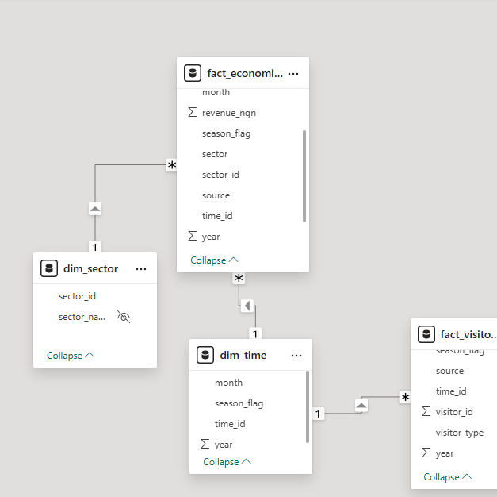
Database Diagram – Tables and Columns
Notes:
Load the Data Set into SQL Server.
Use the SQL Server Management Studio (SSMS) Diagramming tool to produce the Database Diagram.

Slide 19
3 –
Data Preparation

Slide 20
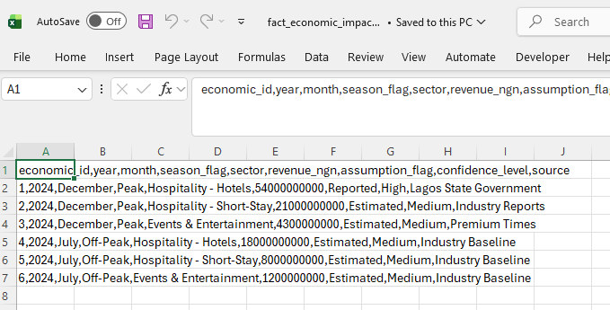
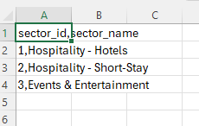
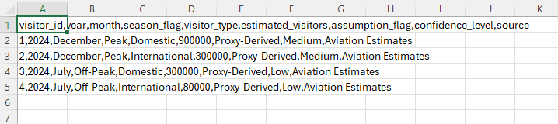
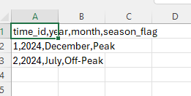
Data Preparation – Data cleansing
ECONOMIC IMPACT TABLE
SECTOR
VISITOR FLOW
TIME
Notes:
Document any data cleansing that was required, any quality issues encountered with the data.

Slide 21
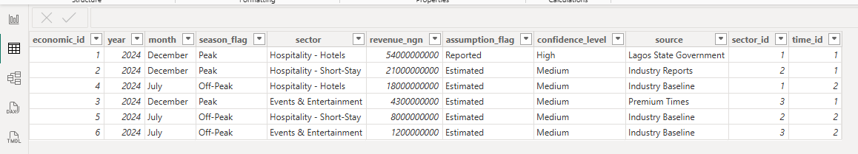
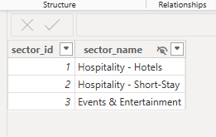
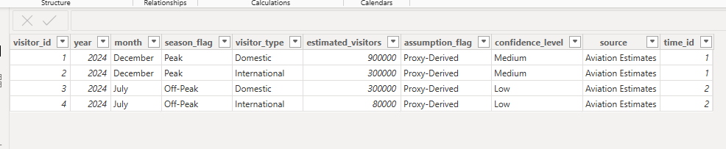
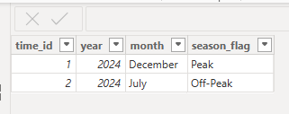
SECTOR
ECONOMIC IMPACT TABLE
VISITOR FLOW
TIME

Slide 22
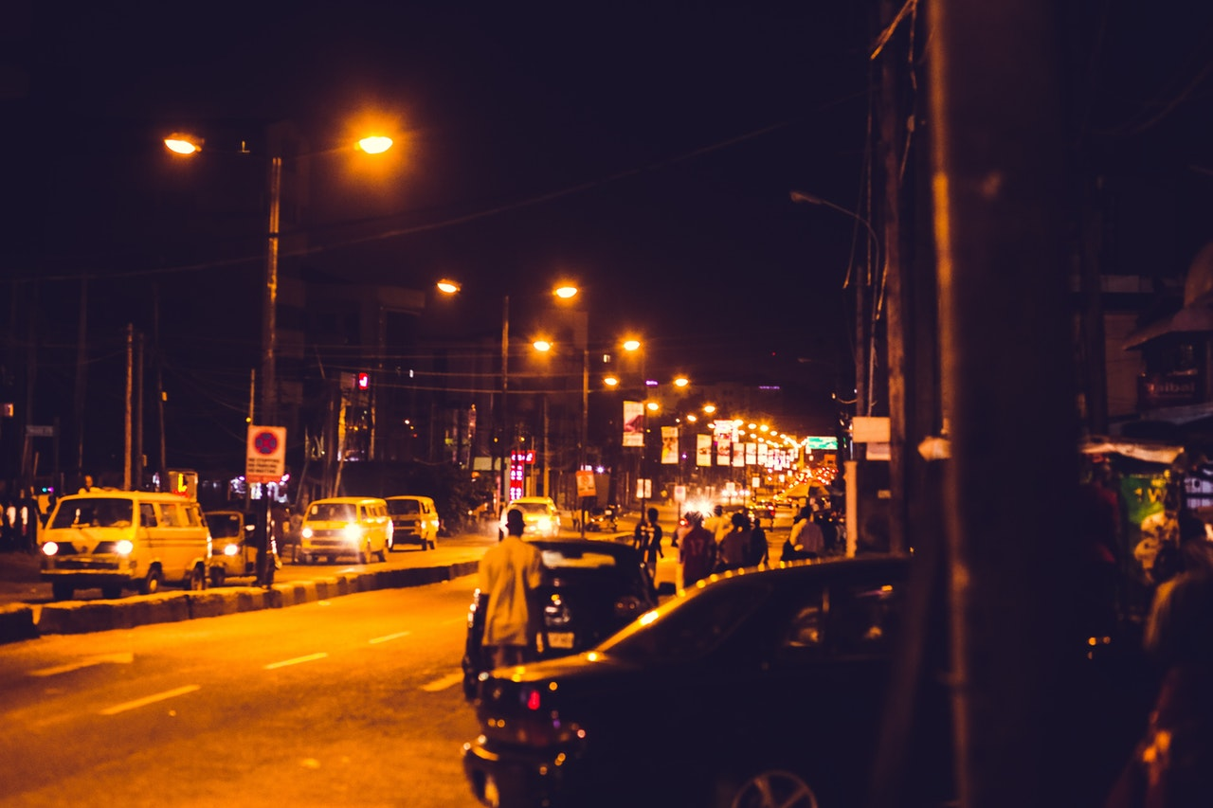
4 –
Modeling
This Photo by Unknown Author is licensed under CC BY-SA-NC

Slide 23
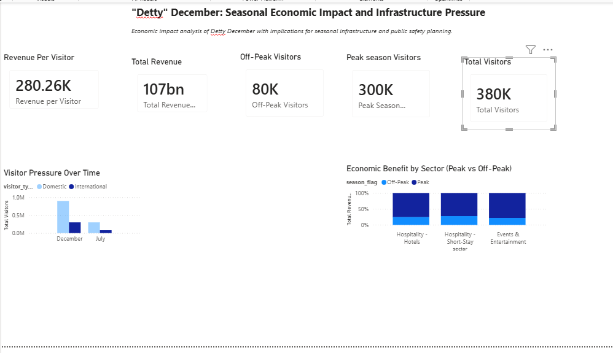
VISUALIZATION

Slide 24
5 –
Evaluation

Slide 25
KEY INSIGHTS
INSIGHT 1 — Detty December Generates a Significant but Short-Lived Economic Surge
(BQ1: Total economic impact)
What the data shows
Economic activity spikes sharply during the December peak period.
A substantial share of annual tourism-related revenue is generated within a narrow time window.
What this means
Detty December is economically valuable, but its benefits are highly time-bound.
Revenue inflows are concentrated over weeks, not spread evenly across the year.
Policy implication
Lagos State should treat Detty December as a seasonal economic event, not a continuous revenue stream.
Budgeting, infrastructure provisioning, and emergency planning must reflect this temporal concentration.
Notes:
The answer to the question from Slide 21 needs to be supported by the data visualized in the previous steps.

Slide 26
KEY INSIGHTS
INSIGHT 2 — Economic Benefits Are Concentrated in a Few Sectors
(BQ2: Sector contribution)
What the data shows
Hospitality (hotels and short-stay accommodation) captures the largest share of revenue.
Events & entertainment follow closely.
Aviation contributes indirectly, serving as a proxy for inbound visitor demand.
What this means
Economic gains are not evenly distributed across sectors.
A small number of industries benefit disproportionately from Detty December.
Policy implication
Sector-specific mechanisms (e.g., seasonal levies, tourism charges, or public-private partnerships) could be used to:
  Reinvest peak-season gains into public services
  Offset the strain placed on roads, healthcare, and emergency response systems
This supports equitable cost-sharing between beneficiaries and the public sector.
Notes:
The answer to the question from Slide 21 needs to be supported by the data visualized in the previous steps.

Slide 27
KEY INSIGHTS
INSIGHT 3 — December Revenue Is Highly Concentrated Relative to Off-Peak Periods
(BQ3: Concentration of economic activity)
What the data shows
Peak-season (December) revenue significantly exceeds off-peak revenue.
The peak-to-off-peak ratio confirms strong seasonality in economic activity.
What this means
Lagos experiences an economic intensity shock during December.
Infrastructure and services designed for average demand are temporarily overwhelmed.
Policy implication
Static, year-round infrastructure planning is insufficient.
Seasonal scaling is required for:
  Traffic management
  Emergency medical services
  Crowd control and public safety operations
Notes:
The answer to the question from Slide 21 needs to be supported by the data visualized in the previous steps.

Slide 28
KEY INSIGHTS
INSIGHT 4 — Economic Gains Are Accompanied by Elevated Public Safety Risk
(Cross-cutting insight: economics + transport safety)
What the data suggests when combined with real-world context
Increased visitor volumes coincide with:
  Road congestion
  Higher accident risk
  Slower emergency response times (as evidenced by recent incidents)
What this means
Economic success without corresponding operational scaling increases the risk of preventable loss of life.
The cost of inaction is borne by residents and visitors, not revenue-generating sectors.
Policy implication
Lagos State should implement peak-season emergency protocols, including:
  Temporary ambulance deployment
  Dedicated emergency lanes during major events
  Data-driven traffic and crowd monitoring dashboards
Notes:
The answer to the question from Slide 21 needs to be supported by the data visualized in the previous steps.

Slide 29
KEY INSIGHTS
INSIGHT 5 — Detty December Is Predictable, Making Proactive Planning Feasible
(Strategic insight)
What the data shows
Seasonal patterns repeat consistently.
Visitor and revenue surges are not random.
What this means
The risks associated with Detty December are foreseeable, not unavoidable.
Data-driven planning can reduce harm without reducing economic benefits.
Policy implication
Establish a Detty December Operations Framework:
  Seasonal budgeting
  Inter-agency coordination (transport, health, emergency services)
  Real-time monitoring during peak weeks
Notes:
The answer to the question from Slide 21 needs to be supported by the data visualized in the previous steps.

Slide 30
Key Takeaways for Decision-Makers
Detty December delivers high economic returns within a short time window.
A substantial share of tourism-related revenue is generated during December, particularly within hospitality,
entertainment, and aviation-linked sectors.
This concentration makes Detty December economically valuable but operationally intense.
Seasonal economic gains create predictable pressure on transport and emergency systems.
The surge in visitors and road usage during peak periods places strain on infrastructure and emergency
response capacity, increasing the risk of delayed medical response and preventable road-related incidents
if services are not scaled accordingly.
Proactive, seasonal planning can preserve economic benefits while reducing public safety risk.
Because peak periods are predictable, Lagos State can mitigate risk through temporary, data-driven
interventions such as peak-season ambulance deployment, traffic management adjustments,
and inter-agency coordination without compromising economic activity.
Notes:
The answer to the question from Slide 21 needs to be supported by the data visualized in the previous steps.

